Slide 1


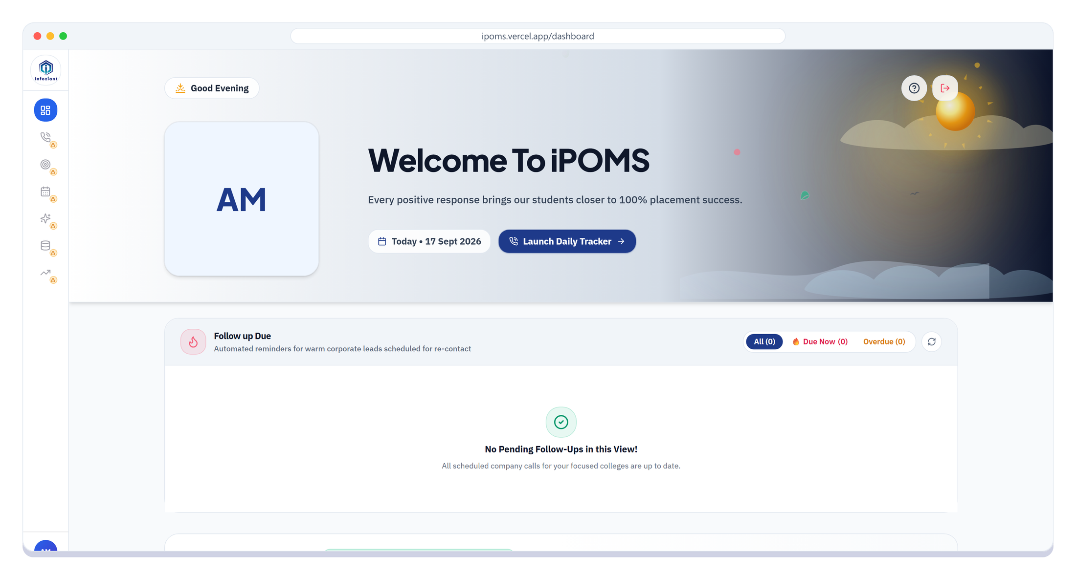

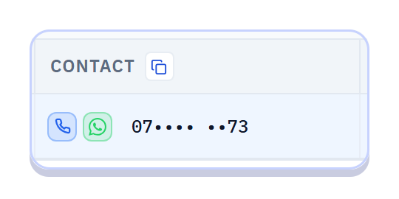
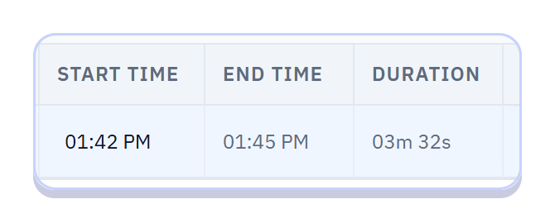


PRODUCT DEMO
iPOMS
Infoziant Placement Operations
Management System
One platform for every call, lead, drive and report.
PRESENTED BY
A. MOHANARADHA
www.infoziant.com
ipoms.vercel.app
Daily Tracker
Daily Leads
Weekly Tracker
Reports
Notes:
Welcome. Today I'll show how iPOMS, our Placement Operations Management System, helps coordinators every day.
It brings the call tracker, leads, weekly drive tracker and reports into one place.
Live app: ipoms.vercel.app

Slide 2





THE CHALLENGE
From scattered spreadsheets to one shared system
What a coordinator's day looked like before, and what changes with iPOMS
BEFORE
WITH iPOMS
Many Excel files, many versions
One system, always in sync
A separate Excel tracker for every college and month
One login for every college and every module
The same company typed into file after file
Contacts picked from a 3,500+ company database
Follow-ups kept in memory, and quietly missed
Automatic sync, reminders and follow-up alerts
Leaders chasing files to see real progress
A live team dashboard and one-click reports
3,500+
21
6
1 click
companies in one database
partner colleges covered
report types, ready to export
to call or WhatsApp a contact
iPOMS · Infoziant Placement Operations Management System
02 / 08
Notes:
Before iPOMS we maintained separate Excel trackers for each college and each month.
The same company was re-typed again and again, follow-ups depended on memory, and leaders had to chase files for updates.
iPOMS replaces all of that with one system: one login, one company database, automatic sync and reminders, and live dashboards.

Slide 3







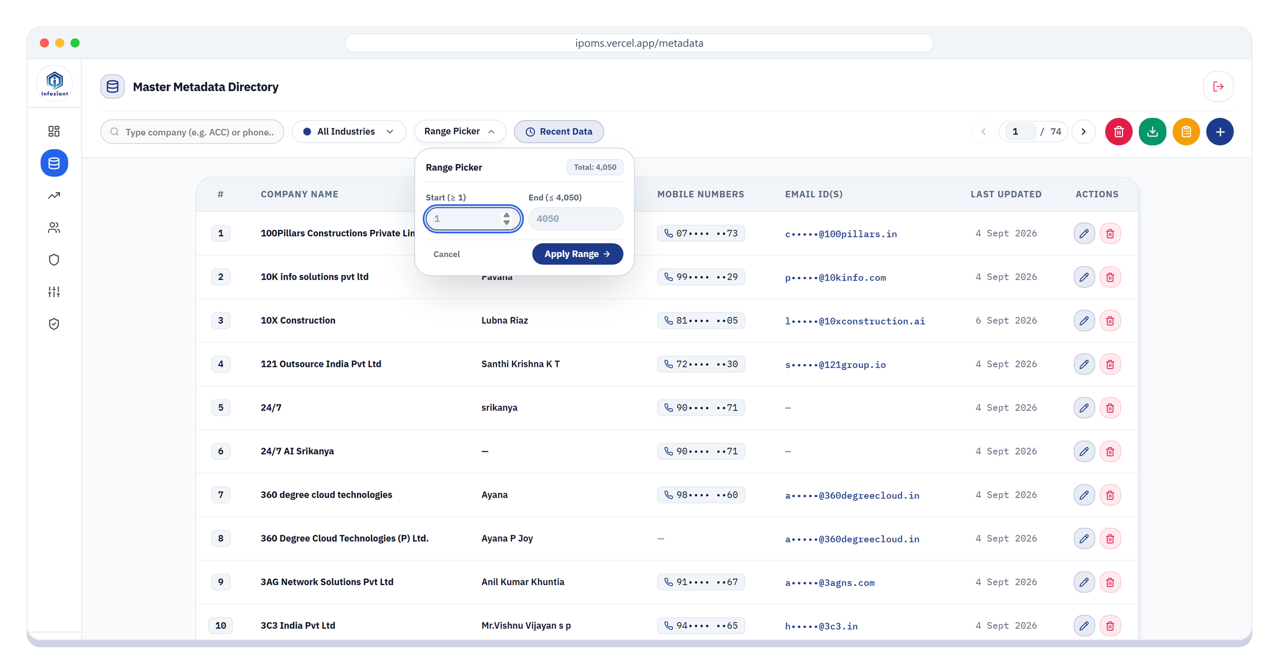



ONE CONNECTED FLOW
One connected flow, from first call to final report
Enter data once, and every module further down the line picks it up
Master Database
Daily Tracker
Daily Leads
Weekly Tracker
Reports
3,500+ companies
Every call logged
Positives and JDs
The drive pipeline
PDF, Excel, Image
3,500+ companies, one master list
Duplicates merged, so one company is one row
Range Picker
Each coordinator works their own S.No range, like 1 to 500
Pagination with page jump
Type a page number and go straight there
Find anyone in seconds
Search by company, HR name or mobile number
iPOMS · Infoziant Placement Operations Management System
03 / 08
Notes:
Everything is connected. Companies live in one master database of more than 3,500 companies.
Coordinators load contacts from it into the Daily Tracker, positive calls move to Daily Leads and the Weekly Tracker, and reports are generated from that data.
The database has pagination with page jump, search, and a Range Picker so each coordinator can work a separate serial-number range.

Slide 4

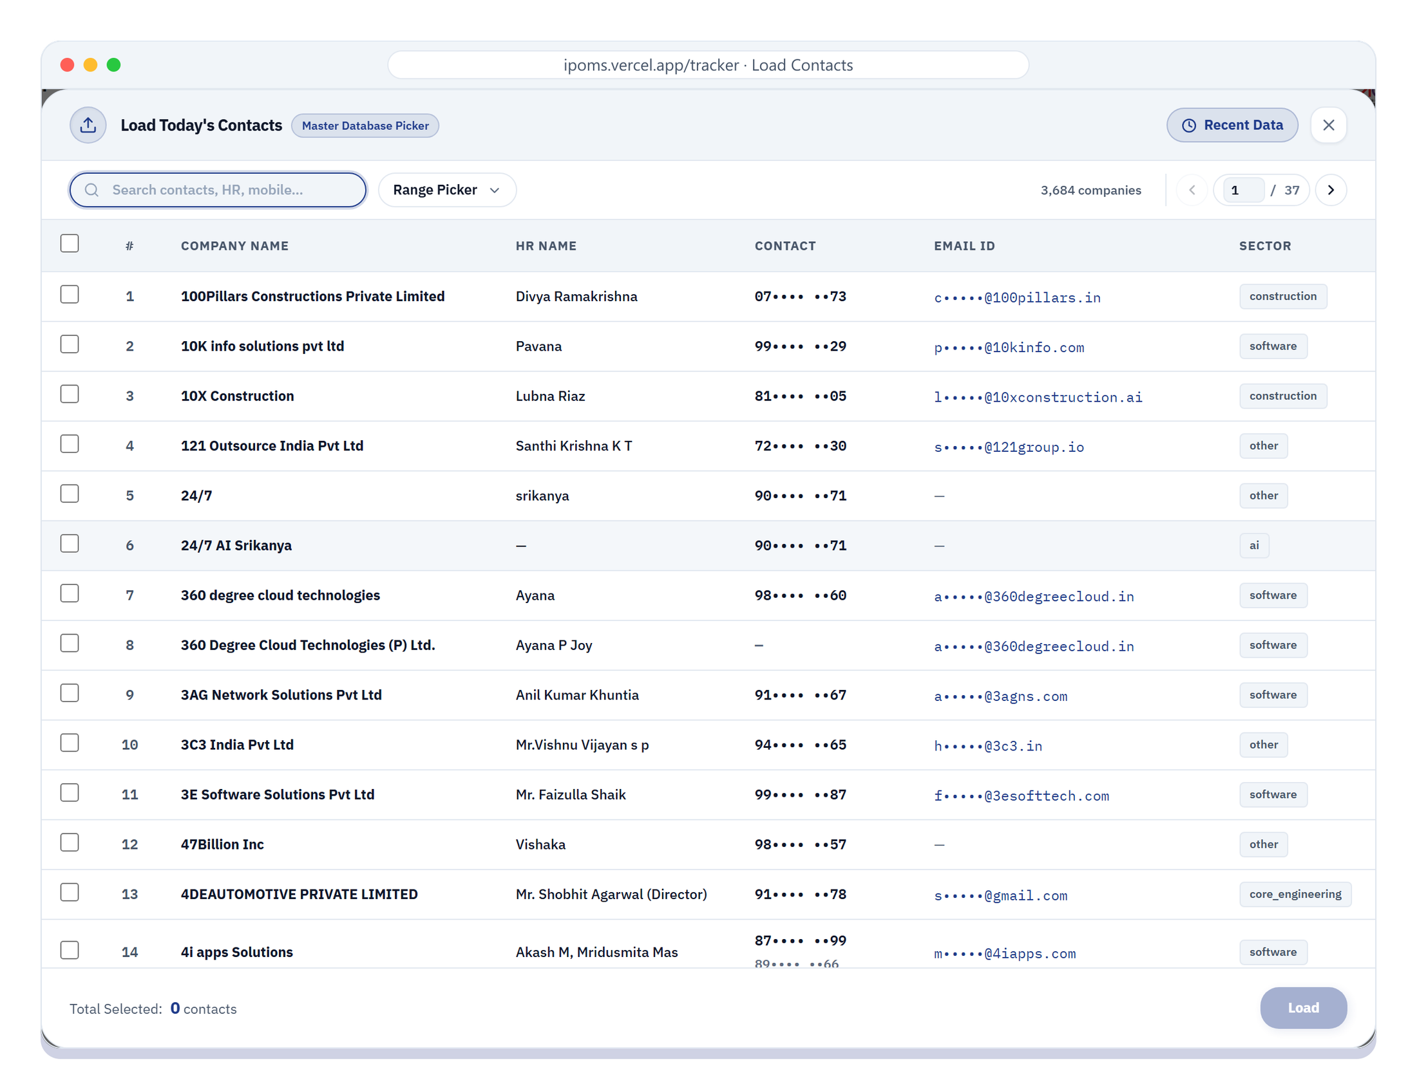



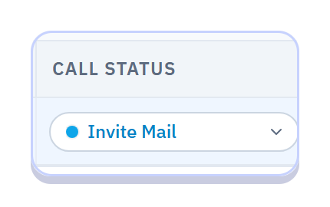

DAILY TRACKER
Log a call in seconds, not minutes
Contacts come straight from the database, and the tracker fills in the rest
Call or WhatsApp in one click
Calls connect through Microsoft Phone Link; WhatsApp opens on the web or desktop app
Timing captured for you
Press Spacebar for the start time; end time and duration fill in automatically
Every change saves itself
Pick a call status and the row auto-saves. There is no Save button to forget
iPOMS · Infoziant Placement Operations Management System
04 / 08
Notes:
The Daily Tracker is where we spend most of the day.
Instead of typing contacts, we load them from the master database, with search and the Range Picker.
Each phone number has a call button that connects through Microsoft Phone Link, and a WhatsApp button that opens WhatsApp Web or the desktop app.
Press Spacebar for the start time; end time and duration are captured automatically, and every change auto-saves.

Slide 5

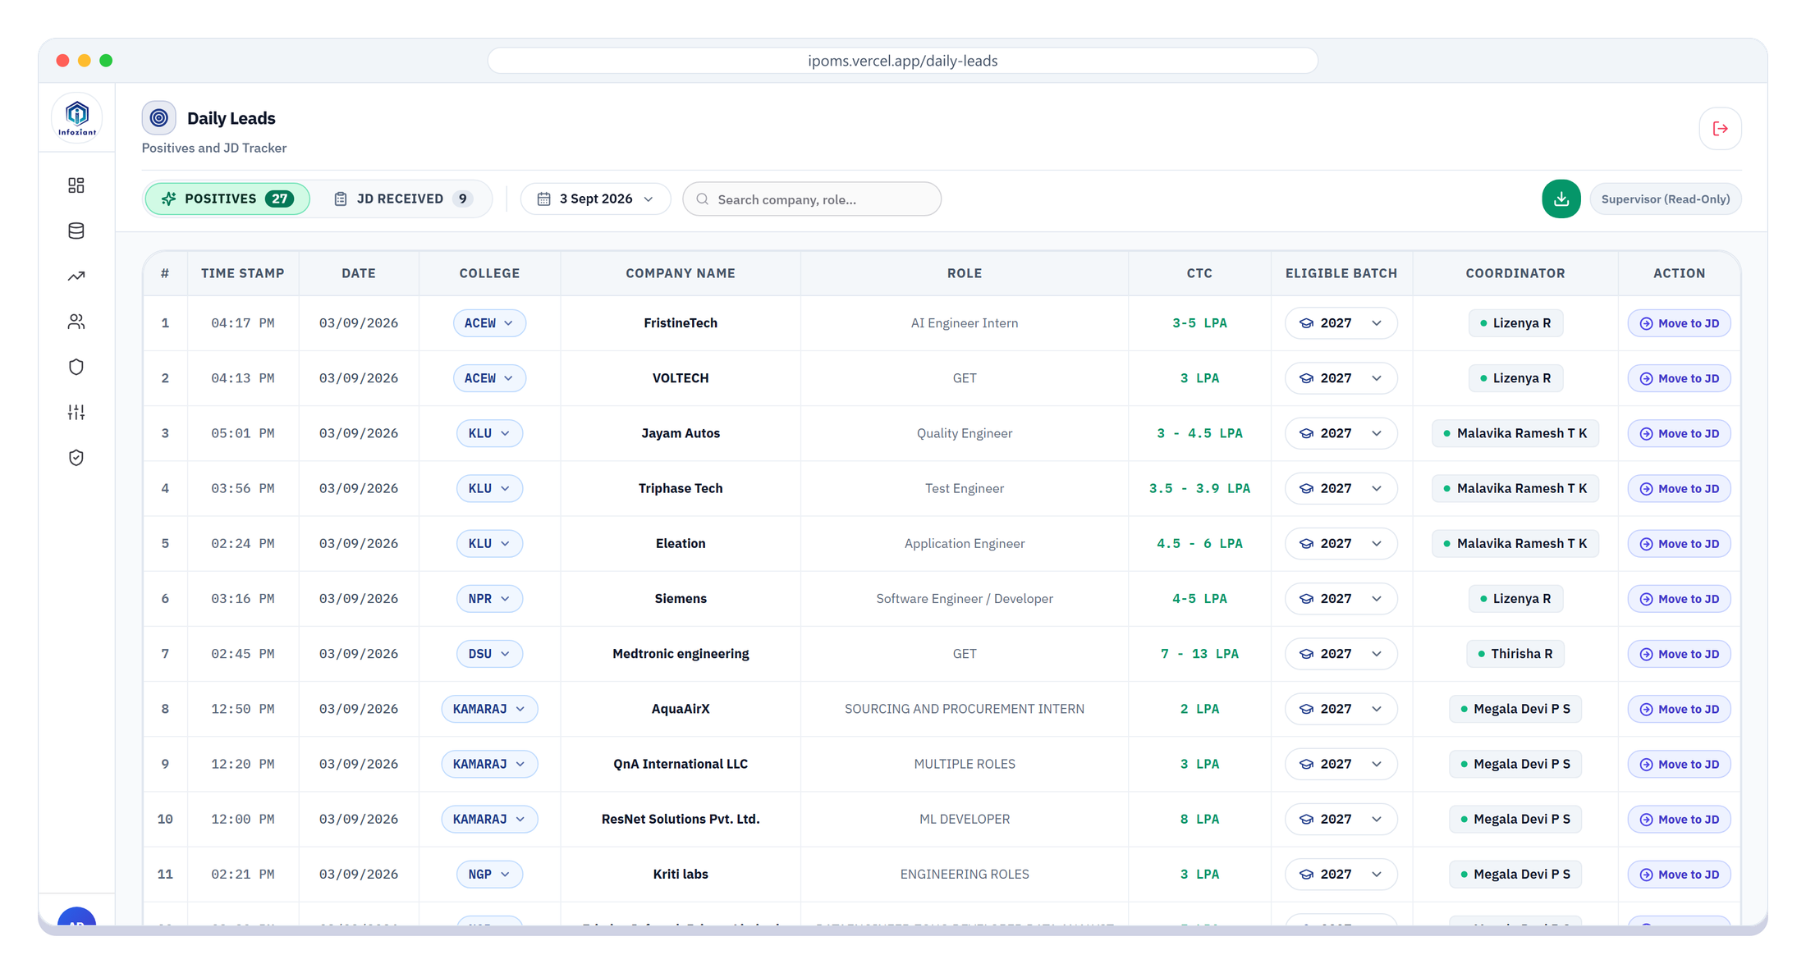
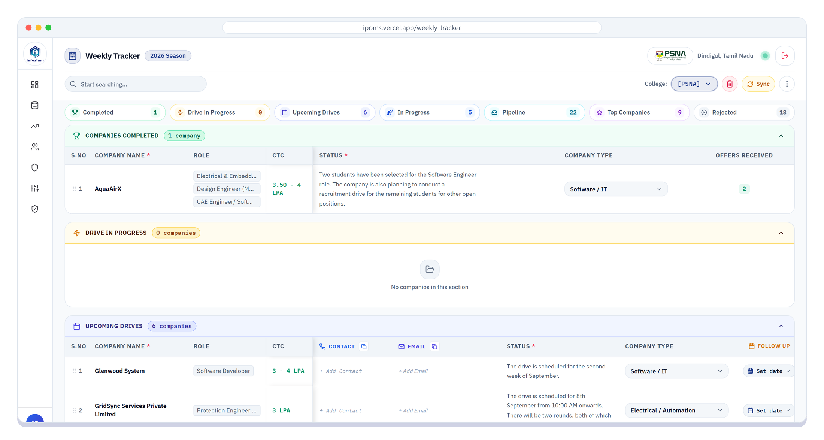
SYNC & FOLLOW-UPS
Every positive call moves forward on its own
Sync buttons when you want it now, automatic jobs for the day you forget
ON SAVE
Invite Mail calls flow forward
They land in the Weekly Tracker pipeline, and one Sync pulls them into Daily Leads
8:00 PM
Reminder email
Lists Invite Mail calls not yet in the Weekly Tracker
10:00 PM
Automatic safety net
Syncs whatever is left, and shows an alert at your next login
DASHBOARD
Follow-ups stay visible
Due Now and Overdue follow-ups show when you log in
iPOMS · Infoziant Placement Operations Management System
05 / 08
Notes:
Positive calls don't need to be copied anywhere.
An Invite Mail call goes into the Weekly Tracker pipeline, and the Sync button pulls positives into Daily Leads.
If something is missed, an 8 PM email reminds the coordinator, and at 10 PM the system syncs it automatically and shows an alert at the next login.
Follow-ups that are due or overdue show on the dashboard, so nothing is forgotten.

Slide 6

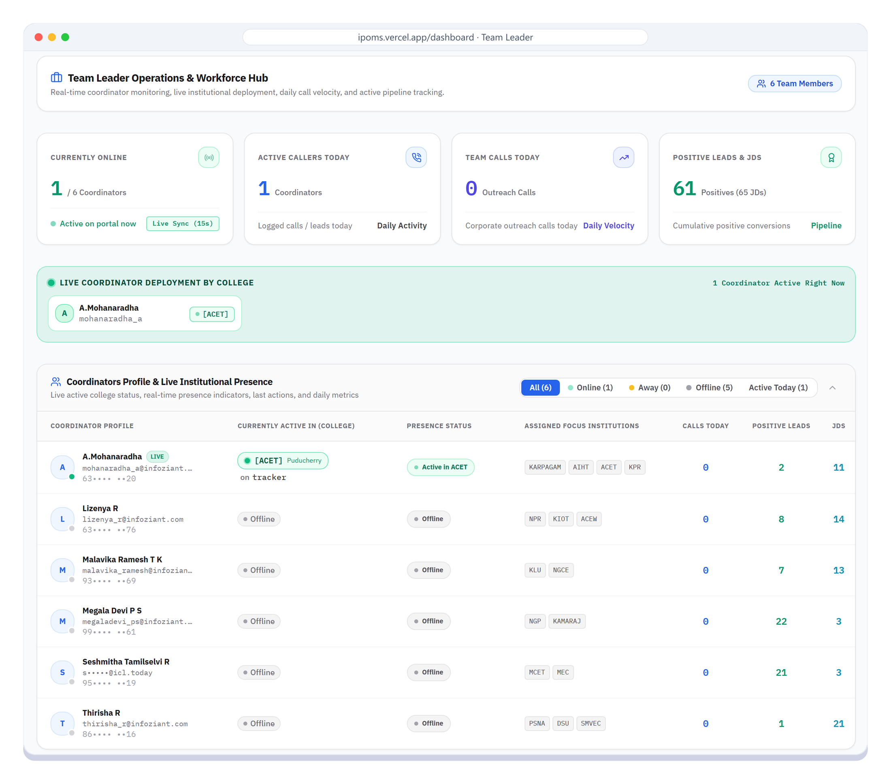



PERFORMANCE
Team performance you can see, not chase
Team Leaders watch activity live: no status calls, no chasing files
Live presence
Calls made today
Who is online, away or offline, and the college they are on
Per coordinator, refreshed every 15 seconds
Positives and JDs
Call duration
Each coordinator's positive leads and JDs received
Start, end and duration recorded on every call
Month-over-month comparison of each coordinator's calls and conversions
NEXT
iPOMS · Infoziant Placement Operations Management System
06 / 08
Notes:
For Team Leaders, performance is visible live on the dashboard.
It shows who is online, which college and page each coordinator is working on, calls made today, and positives and JDs received.
Every call's start time, end time and duration is recorded.
Next on the roadmap: month-over-month comparison of each coordinator's statistics.

Slide 7
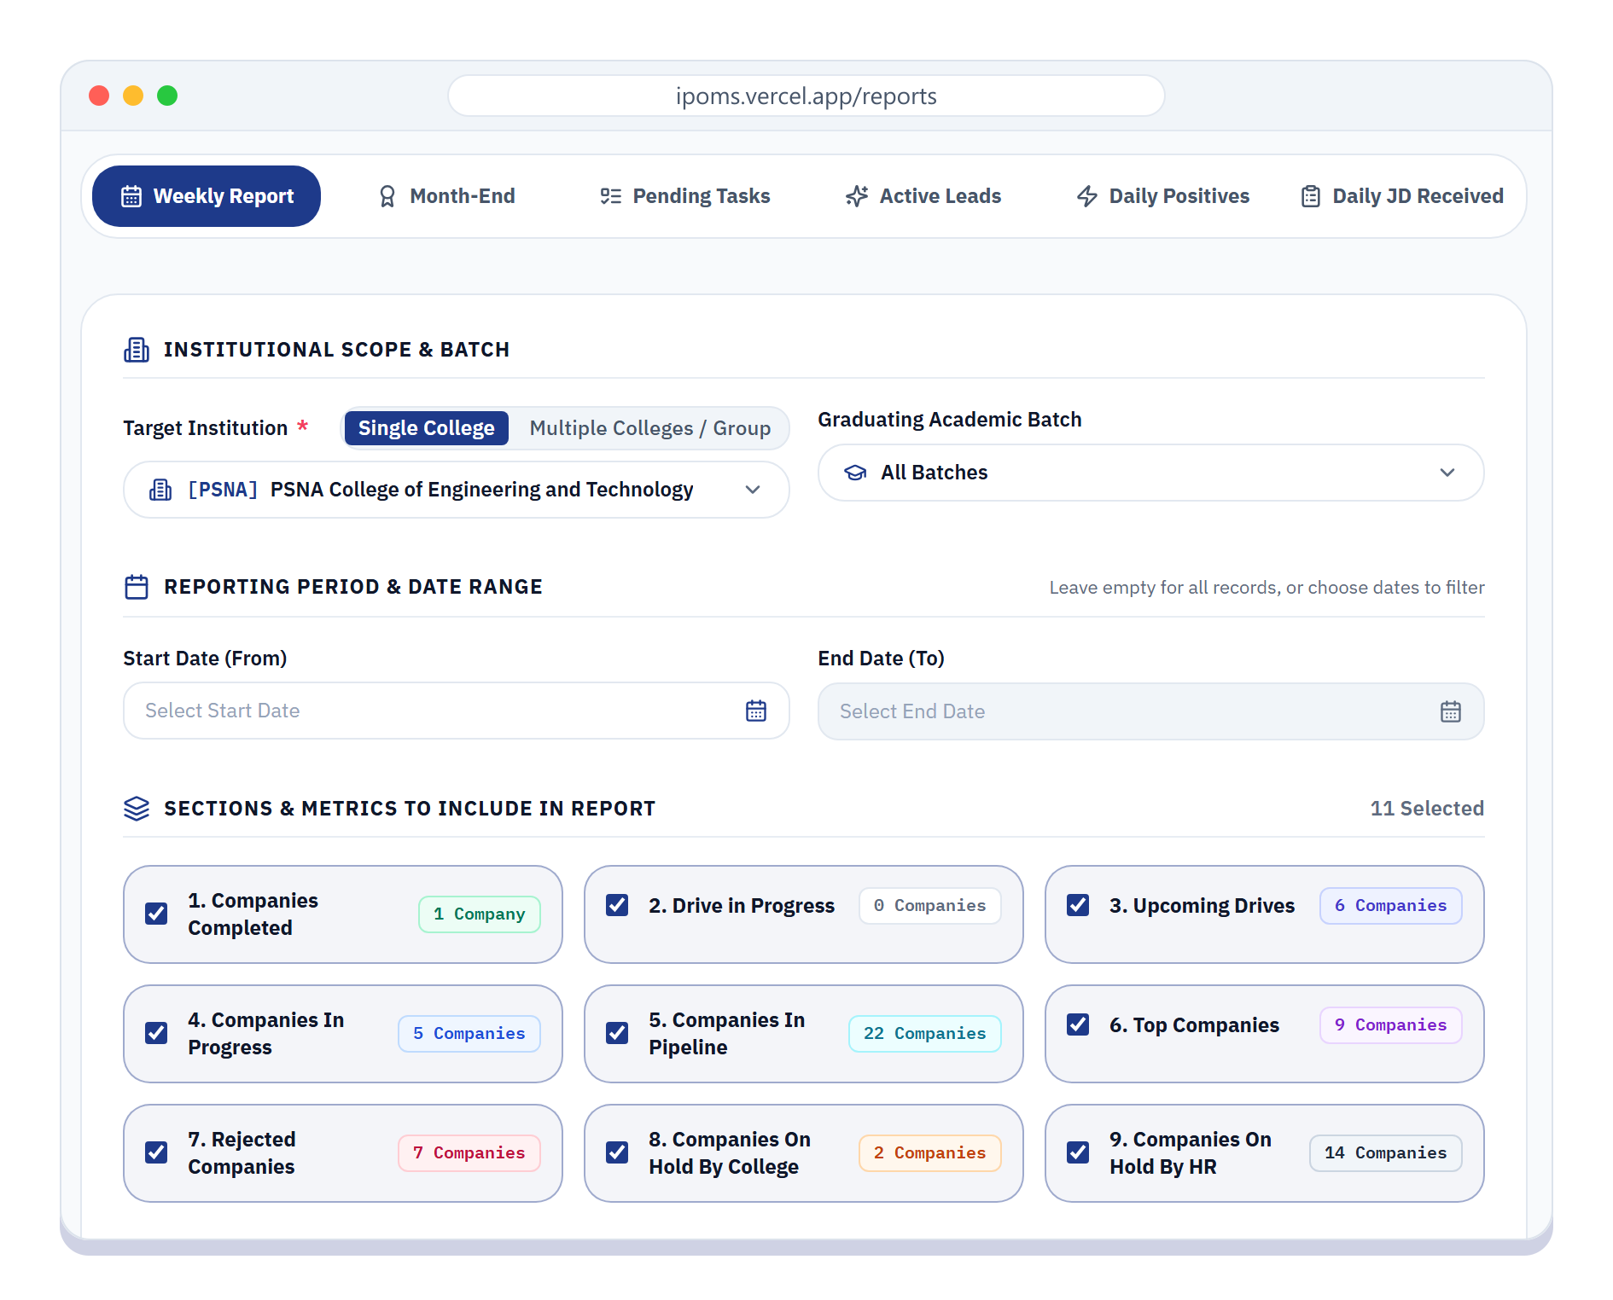
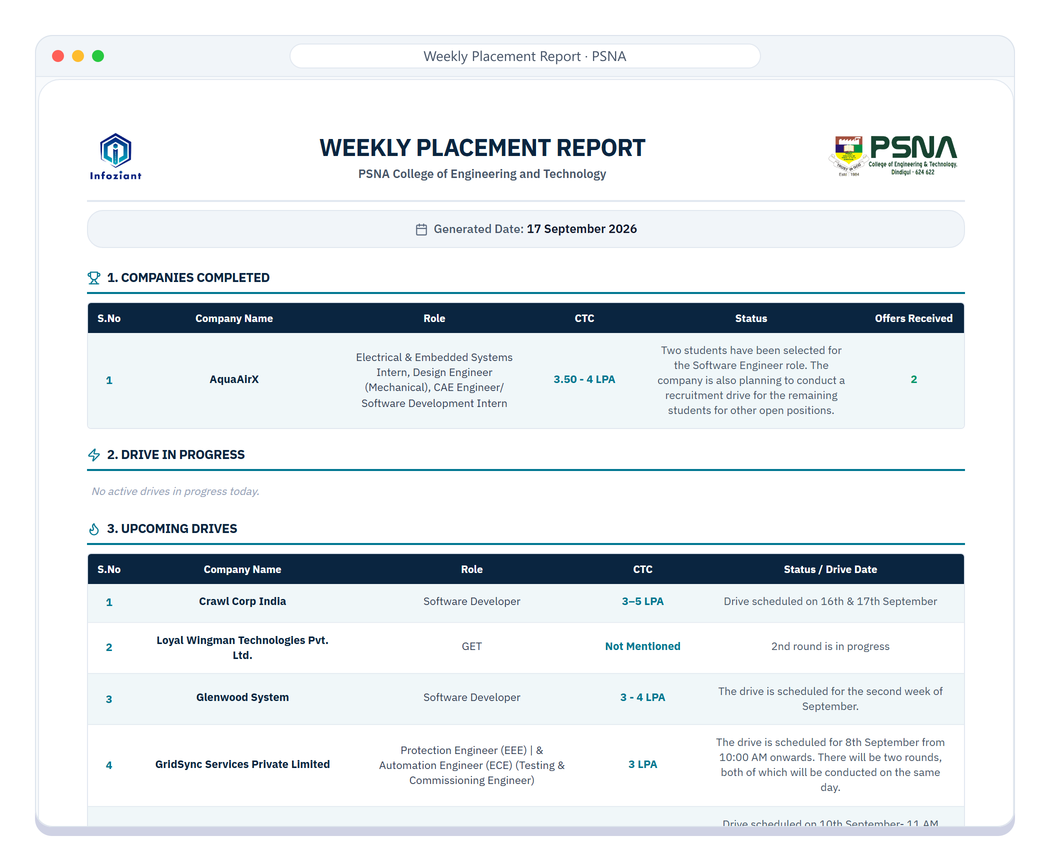




REPORTS
Reports in one click, in the format you need
Pick one college or a group of colleges, choose the sections, generate
6 REPORT TYPES
Weekly Report
Month-End
Pending Tasks
Active Leads
Daily Positives
Daily JD Received
COVERAGE
One college or many, in one go
EXPORT FORMATS
PDF
Excel
Image
iPOMS · Infoziant Placement Operations Management System
07 / 08
Notes:
Reports that took hours in Excel are now one click.
There are six report types: Weekly, Month-End, Pending Tasks, Active Leads, Daily Positives and Daily JD Received.
A report can cover one college, or several colleges in a single go, and exports as PDF, Excel or an image, ready to share.

Slide 8

Thank you
Questions, and a live walkthrough of iPOMS
Open iPOMS · ipoms.vercel.app
www.infoziant.com
PRESENTED BY
A. MOHANARADHA
Infoziant
Notes:
Thank you. I'm happy to take questions, and to walk through the live application at ipoms.vercel.app.

